Slide 1
Pituitary Gland

Slide 2
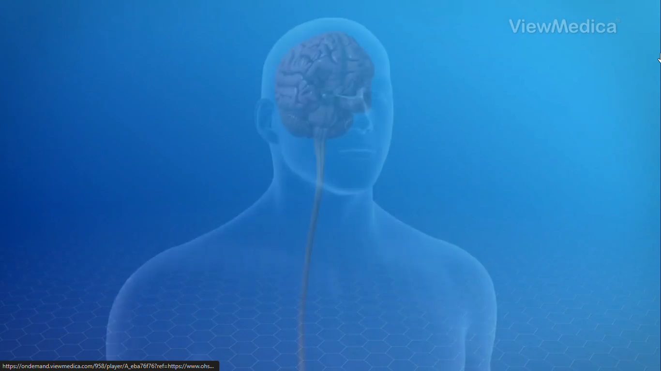

Slide 3
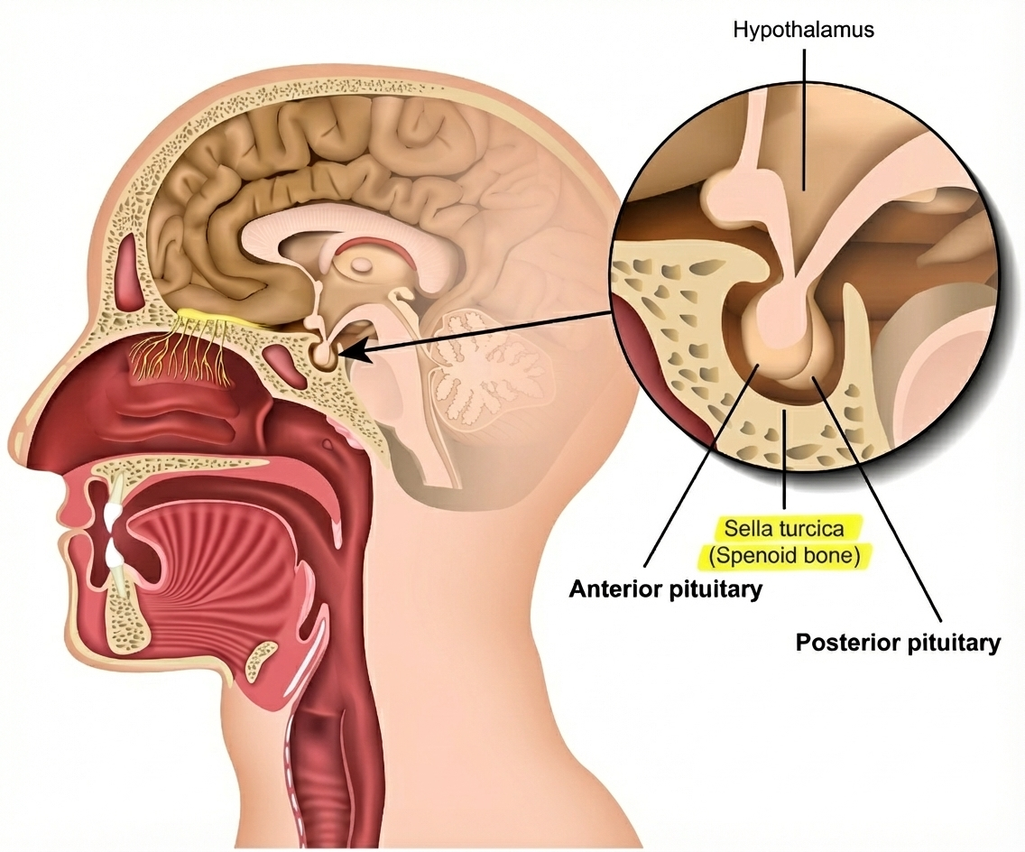

Slide 4
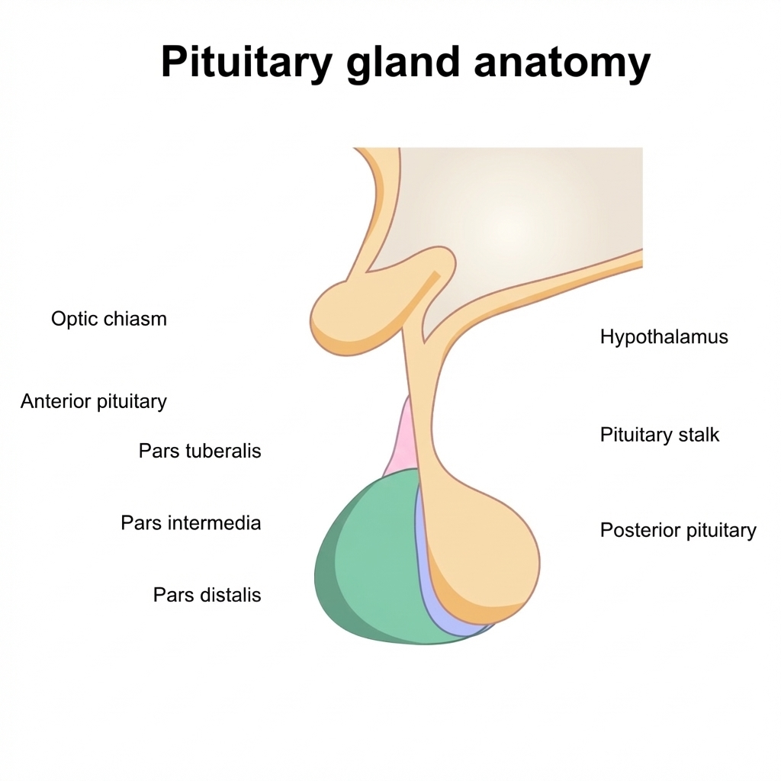









Hypothalamus
Pituitary Stalk

Slide 5
Hypothalamus
Pituitary Stalk
Neurohypophysis
(posterior pituitary)

Slide 6
Hypothalamus
Pituitary Stalk
Adenohypophysis
(anterior pituitary)
Neurohypophysis
(posterior pituitary)

Slide 7
Hypothalamus
Pituitary Stalk
Adenohypophysis
(anterior pituitary)
Neurohypophysis
(posterior pituitary)
Pars distalis
Pars intermedia

Slide 8
Adenohypophysis (anterior pituitary)

Slide 9
Growth hormone (GH)

Slide 10
Growth hormone (GH)
Prolactin (PRL)

Slide 11
Growth hormone (GH)
Prolactin (PRL)
Thyroid stimulating hormone(TSH)

Slide 12
Growth hormone (GH)
Prolactin (PRL)
Thyroid stimulating hormone(TSH)
Adrenocorticotrophic hormone (ACTH)

Slide 13
Growth hormone (GH)
Prolactin (PRL)
Thyroid stimulating hormone(TSH)
Adrenocorticotrophic hormone (ACTH)
Luteinizing hormone (LH)

Slide 14
Growth hormone (GH)
Prolactin (PRL)
Thyroid stimulating hormone(TSH)
Adrenocorticotrophic hormone (ACTH)
Luteinizing hormone (LH)
Follicle stimulating hormone (FSH)

Slide 15
Pars distalis
Growth hormone (GH)
Prolactin (PRL)
Thyroid stimulating hormone(TSH)
Adrenocorticotrophic hormone (ACTH)
Luteinizing hormone (LH)
Follicle stimulating hormone (FSH)

Slide 16
Pars distalis
Growth hormone (GH)
Prolactin (PRL)
Thyroid stimulating hormone(TSH)
Adrenocorticotrophic hormone (ACTH)
Luteinizing hormone (LH)
Follicle stimulating hormone (FSH)
Pars intermedia
7. Melanocyte stimulating hormone (MSH).

Slide 17
Pars distalis
Growth hormone (GH)
Prolactin (PRL)
Thyroid stimulating hormone(TSH)
Adrenocorticotrophic hormone (ACTH)
Luteinizing hormone (LH)
Follicle stimulating hormone (FSH)
Pars intermedia
7. Melanocyte stimulating hormone (MSH).

Slide 18
HPA axis (Hypothalamus – Pituitary – Adrenal axis)

Slide 19
Hypothalamus
Nervous
system
Endocrine
system

Slide 20
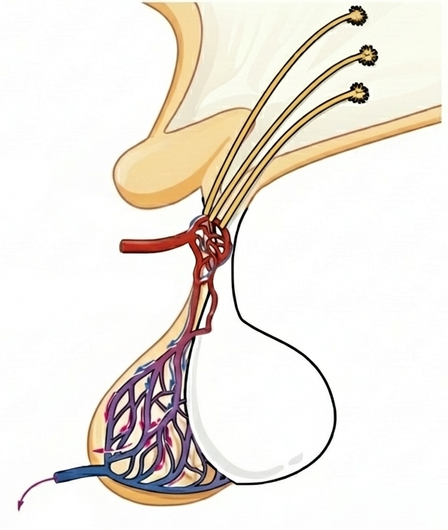
1. Hypothalamus detects stress.
Certain neurons become active.
Hypothalamus
Neurosecretory cells
Anterior Pituitary

Slide 21
1. Hypothalamus detects stress.
Certain neurons become active.
Hypothalamus
Neurosecretory cells
2. Hormones released from hypothalamic neurons are picked up by the hypophyseal portal veins.
Hypophyseal portal veins
Anterior Pituitary

Slide 22
1. Hypothalamus detects stress.
Certain neurons become active.
Hypothalamus
Neurosecretory cells
2. Hormones released from hypothalamic neurons are picked up by the hypophyseal portal veins.
Hypophyseal portal veins
3. CRH from the hypothalamus stimulates the anterior pituitary to release ACTH.
Anterior Pituitary

Slide 23
1. Hypothalamus detects stress.
Certain neurons become active.
Hypothalamus
Neurosecretory cells
2. Hormones released from hypothalamic neurons are picked up by the hypophyseal portal veins.
Hypophyseal portal veins
3. CRH from the hypothalamus stimulates the anterior pituitary to release ACTH.
Anterior Pituitary
4. ACTH travels through blood until it reaches the adrenal glands.

Slide 24
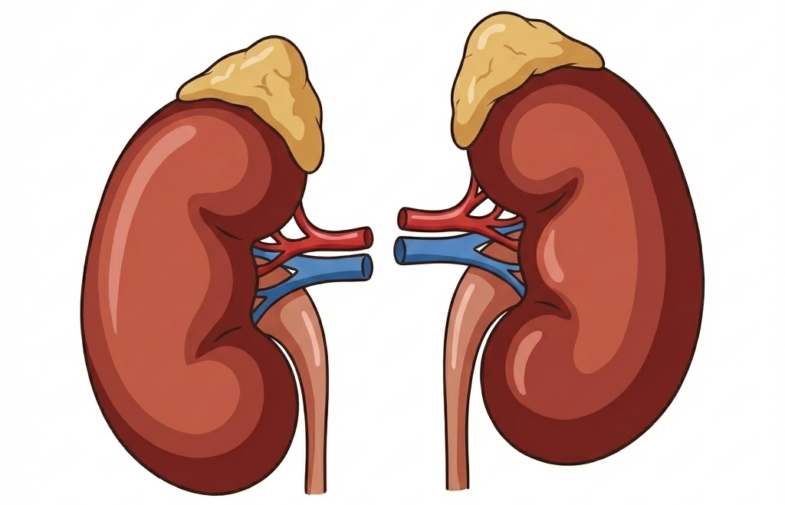
1. Hypothalamus detects stress.
Certain neurons become active.
Hypothalamus
2. Hormones released from hypothalamic neurons are picked up by the hypophyseal portal veins.
3. CRH from the hypothalamus stimulates the anterior pituitary to release ACTH.
Anterior Pituitary
5. In response to ACTH, the adrenal cortex releases cortisol
4. ACTH travels through blood until it reaches the adrenal glands.
Not to scale

Slide 25
Pars distalis
Growth hormone (GH)
Prolactin (PRL)
Thyroid stimulating hormone(TSH)
Adrenocorticotrophic hormone (ACTH)
Luteinizing hormone (LH)
Follicle stimulating hormone (FSH)
Pars intermedia
7. Melanocyte stimulating hormone (MSH).

Slide 26
Growth Hormone (GH)
Controls growth of the body

Slide 27
Growth Hormone (GH)
Controls growth of the body
GH imbalance:
↑ GH (childhood)
↓
Abnormal growth → Gigantism
↓ GH
↓
Stunted growth → Pituitary dwarfism

Slide 28
1. Growth Hormone (GH)
↑ GH (adults / middle age)
↓
Acromegaly
• Severe disfigurement
(especially of the face)
• May cause serious complications
• Can lead to premature death
• Difficult to diagnose early
• Often detected late
(external changes become visible)

Slide 29
2. Prolactin (PRL)
• Regulates growth of mammary glands
• Formation of milk in mammary glands

Slide 30
3. Thyroid Stimulating Hormone (TSH)
TSH
↓
Thyroid gland
↓
Synthesis & secretion
of thyroid hormones

Slide 31
4. Adrenocorticotropic Hormone (ACTH)
ACTH
↓
Adrenal cortex
↓
Steroid hormones
(glucocorticoids)

Slide 32
5. Luteinizing hormone (LH) & 6. Follicle stimulating hormone (FSH)
Stimulate gonadal activity
→ Called gonadotrophins

Slide 33
5. Luteinizing hormone (LH) & 6. Follicle stimulating hormone (FSH)
LH (males)
↓
Testis
↓
Synthesis & secretion
of androgens

Slide 34
5. Luteinizing hormone (LH) & 6. Follicle stimulating hormone (FSH)
LH (males)
↓
Testis
↓
Synthesis & secretion
of androgens
FSH + Androgens
↓
Regulate spermatogenesis

Slide 35
5. Luteinizing hormone (LH) & 6. Follicle stimulating hormone (FSH)
LH (females)
Induces ovulation
(fully mature / Graafian follicle)
Maintains corpus luteum
(formed after ovulation)

Slide 36
5. Luteinizing hormone (LH) & 6. Follicle stimulating hormone (FSH)
LH (females)
Induces ovulation
(fully mature / Graafian follicle)
Maintains corpus luteum
(formed after ovulation)
FSH
Growth & development
of ovarian follicles

Slide 37
7. Melanocyte stimulating hormone (MSH).
MSH
↓
Melanocytes
(melanin-containing cells)
↓
Regulates skin pigmentation

Slide 38

This was CS50 3
For ppt visit : akshayabraham.vercel.app/pituitary.pptx

